Slide 1
pySINDy for System Modeling

Slide 2
Goal in one sentence:
“To create model equations from data using a python implementation of the Sparse Identification of Nonlinear Dynamics (SINDy)”

Slide 3
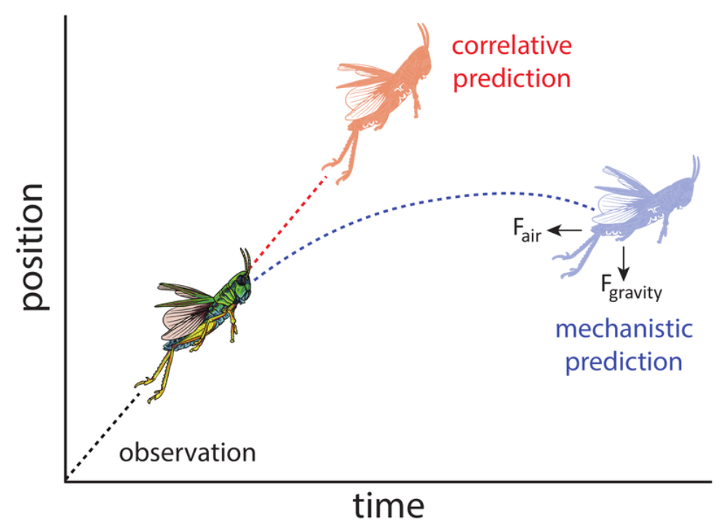
Motivations
Mechanistic modeling and extrapolation
Data-driven modeling + domain knowledge
Maino, James & Kong, Jacinta & Hoffmann, Ary & Barton, Madeleine & Kearney, Michael. (2016). Mechanistic models for predicting insect responses to climate change. Current Opinion in Insect Science. 17. 10.1016/j.cois.2016.07.006.

Slide 4
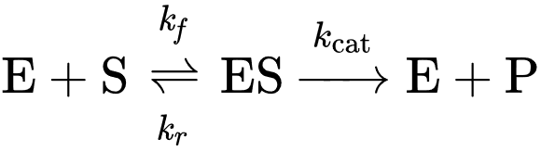
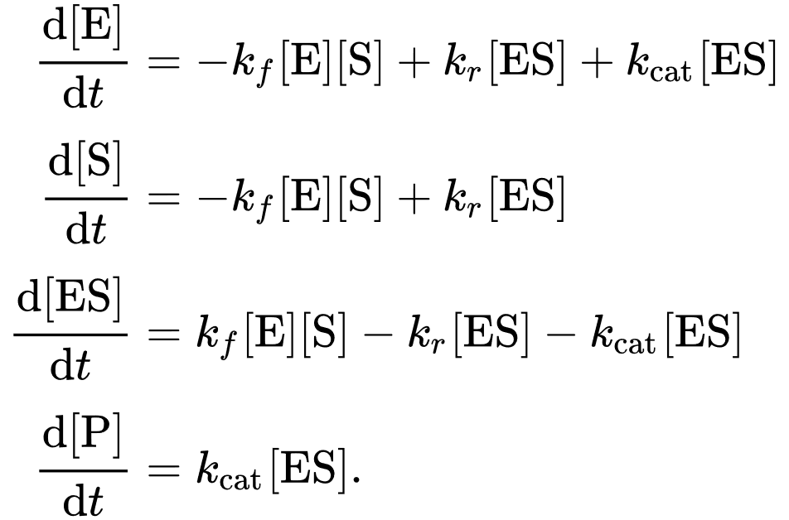
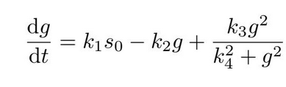
More Specifically…
Gene Regulation Networks
Protein-protein interaction
Michaelis–Menten kinetics
The Law of Mass Action in action
Murray, J.D. (2002). Mathematical Biology: I. An Introduction (3 ed.). Springer. ISBN 978-0-387-95223-9
An equation model of gene concentration
Stephen P. Ellner and John Guckenheimer. Dynamic Models in Biology. Princeton University Press, Princeton, NJ, 1. edition, 2006.

Slide 5
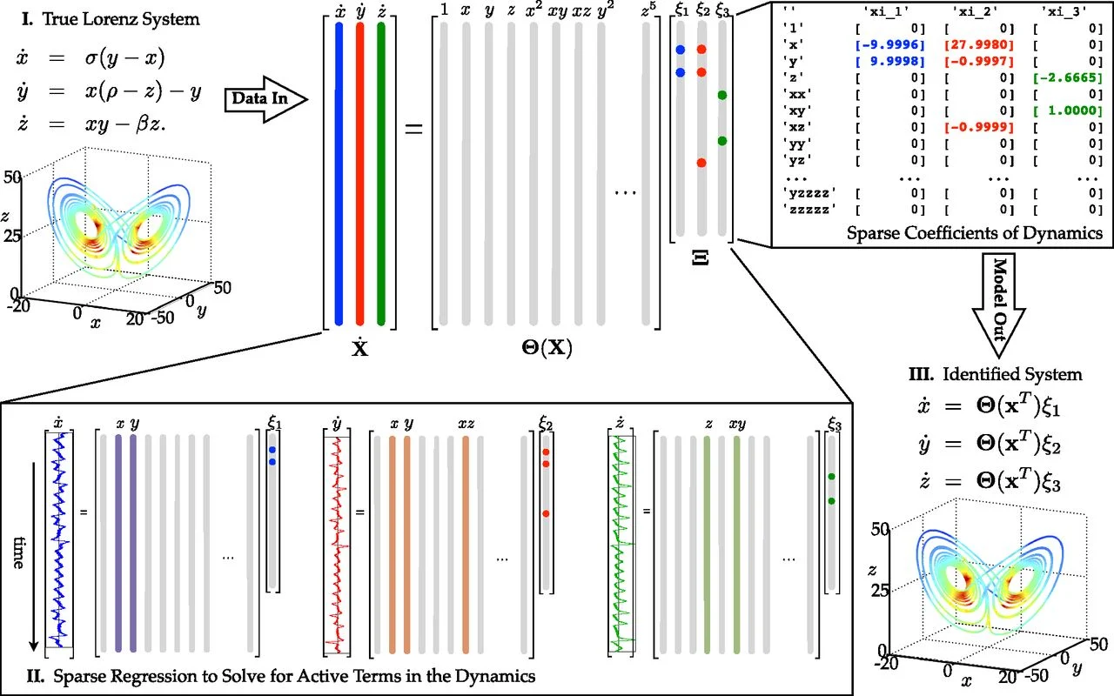
Method: SINDy
Sparse Identification of Nonlinear Dynamics
Compares to differentiated data
Multiple methods of generating
Similar to linear regression
But on chosen functions of the features vs. just the feature itself (hence nonlinearity)
Symbolic regression
Sparse Identification
Method of finding the relevant functions
Steven L. Brunton, Joshua L. Proctor, and J. Nathan Kutz. Discovering governing equations from data by sparse identification of nonlinear dynamical systems. Proceedings of the National Academy of Sciences, 113(15):3932–3937, 2016.

Slide 6
pySINDy Package
Implements various implementations of SINDy
Control variables
Trapping
PDEs (partial differential equations)
Implicit
Code structure
Create model
Function library
Model Optimizer
Fit model to training data with time data
Output model
Simulate
Predict
Example Code
library = ps.PolynomialLibrary(degree=3,
include_bias=False,
include_interaction=True)
stlsq_optimizer = ps.STLSQ(threshold=0.1)
tvals = time data same length as training_data
training_data = np.array of shape (time, features)
model = ps.SINDy(feature_library=library,
optimizer=stlsq_optimizer)
model.fit(training_data, t=tvals)

Slide 7
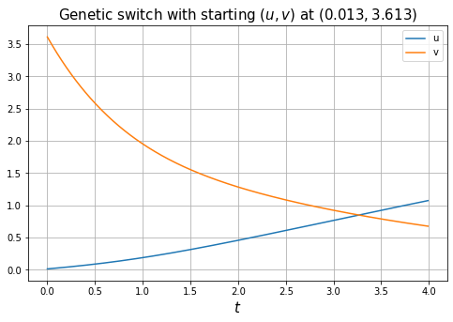
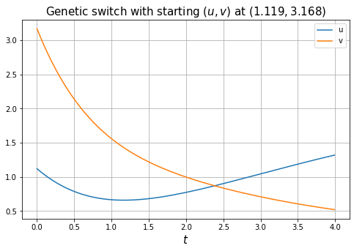
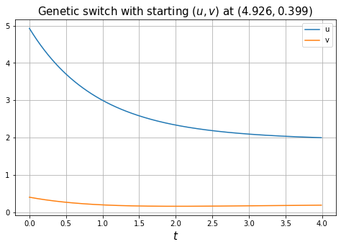
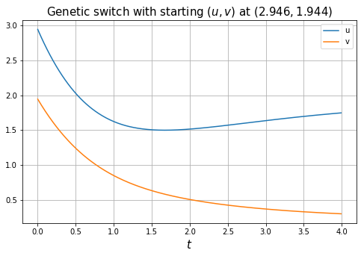
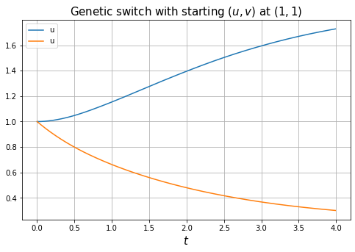
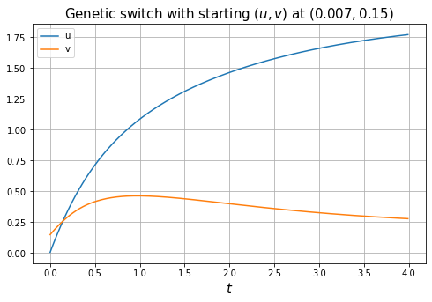
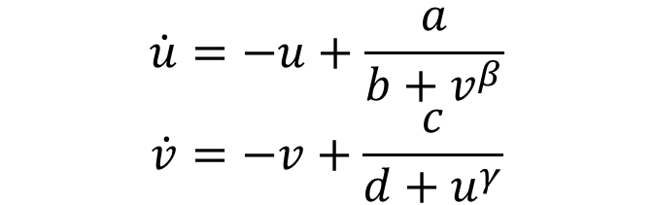
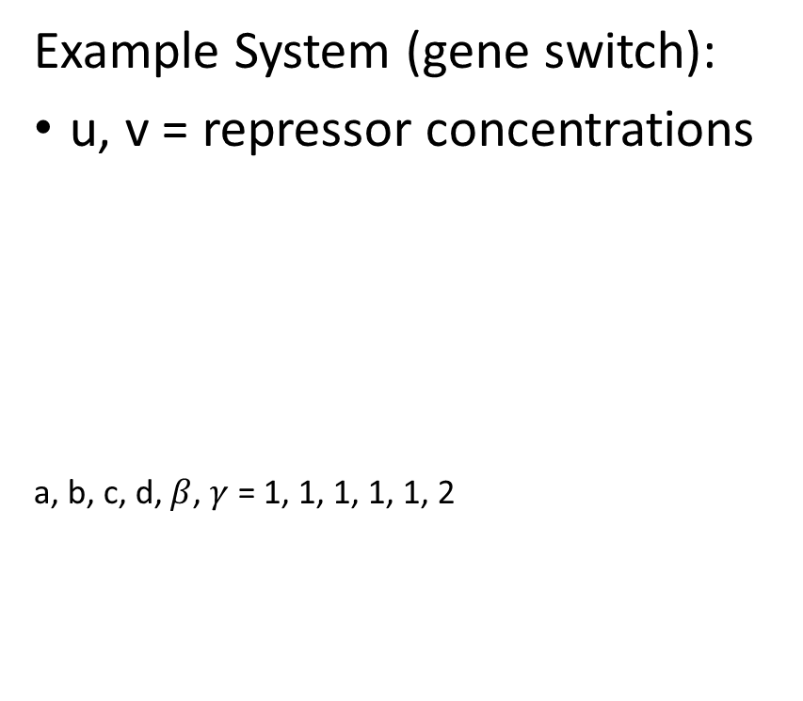
Method: SINDy
Example System (gene switch):
u, v = repressor concentrations
a, b, c, d, $β$, $γ$ = 1, 1, 1, 1, 1, 2
$$\dot{u}=−u+\frac{a}{b+v^{β}}$$
$$\dot{v}=−v+\frac{c}{d+u^{γ}}$$

Slide 8
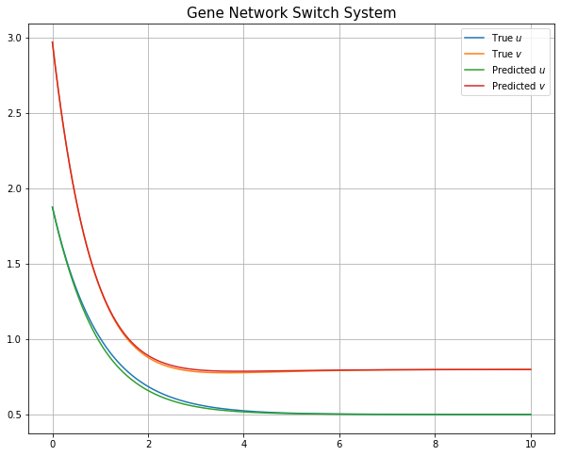
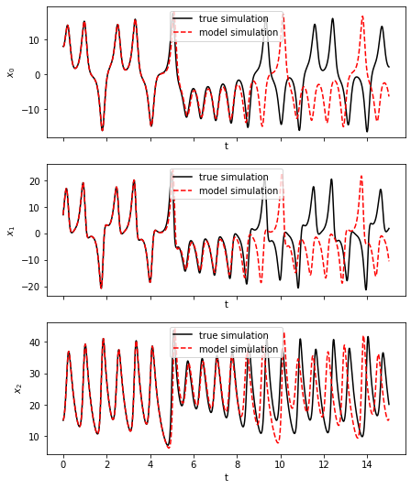
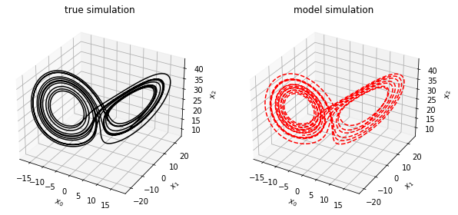
Method: SINDy
Illustrated SINDy Performance without noise
50 samples w/ 1000 time points
Unrealistic
Average MSE across all samples: 0.2132
Illustrated SINDy Performance without noise
Lorenz System
Steven L. Brunton, Joshua L. Proctor, and J. Nathan Kutz. Discovering governing equations from data by sparse identification of nonlinear dynamical systems. Proceedings of the National Academy of Sciences, 113(15):3932–3937, 2016.

Slide 9
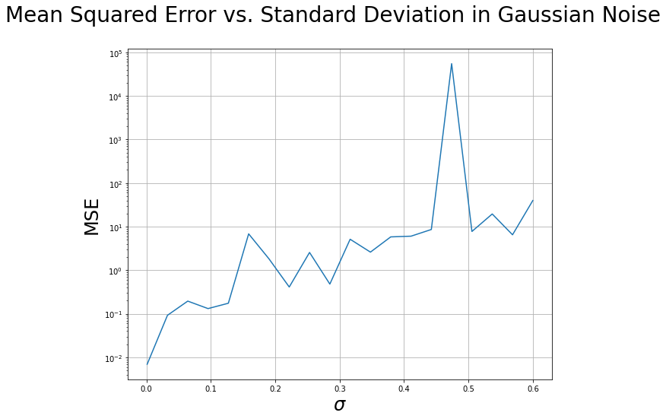
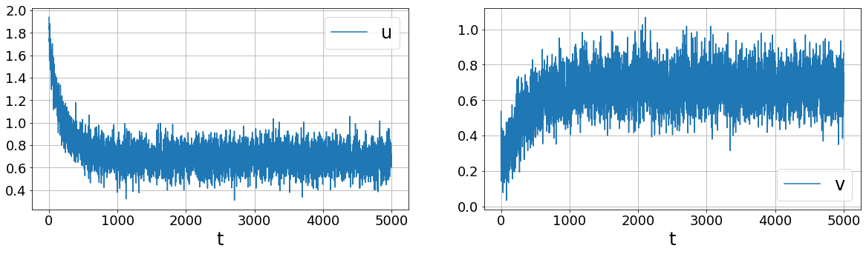
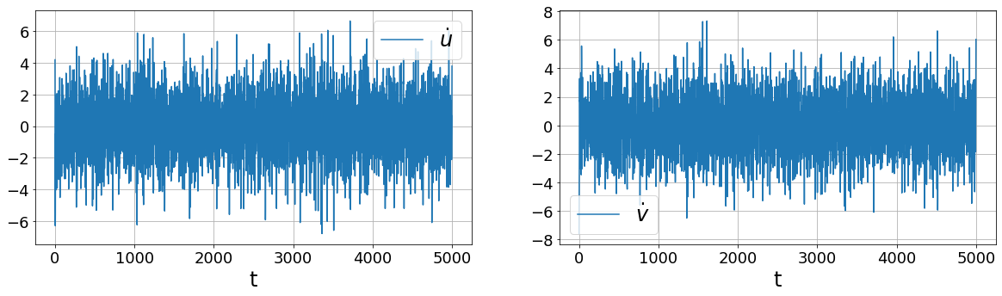
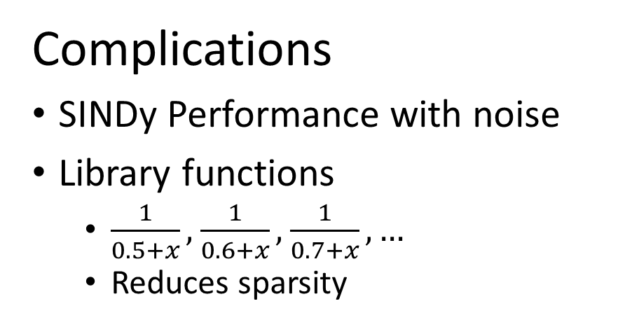
Method: SINDy
Complications
SINDy Performance with noise
Library functions
$\frac{1}{0.5+x},$ $\frac{1}{0.6+x},$ $\frac{1}{0.7+x},…$
Reduces sparsity

Slide 10
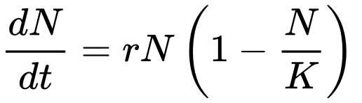
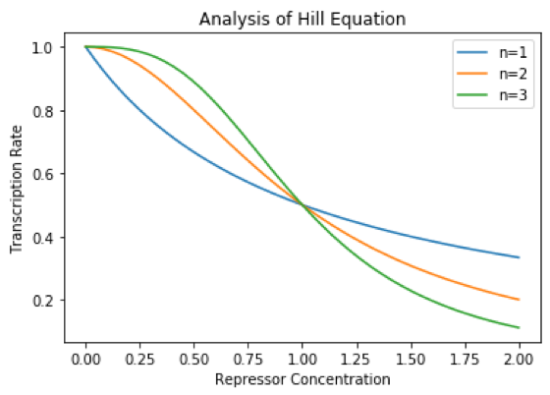

Method: SINDy
$$\dot{u}=−u+\frac{a}{b+v^{β}}$$
$$\dot{v}=−v+\frac{c}{d+u^{γ}}$$
Rational Functions
Hill functions
Thresholds
Switches
Equation model of a gene switch
Equation model of logistic growth for ecology/populations
Example equation model for gene concentration

Slide 11

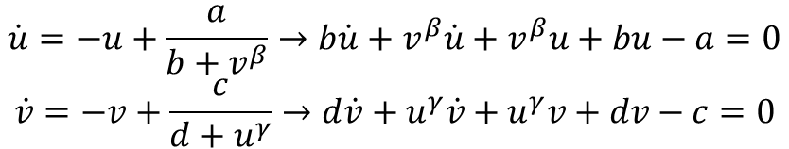
Method: Implicit SINDy
$$\dot{X}=\frac{N\left(X\right)}{D\left(X\right)}⇒Θ\left(X, \dot{X}\right)Ξ_{null}=0$$
Implicit SINDy algorithm
N. M. Mangan, S. L. Brunton, J. L. Proctor and J. N. Kutz, "Inferring Biological Networks by Sparse Identification of Nonlinear Dynamics," in IEEE Transactions on Molecular, Biological and Multi-Scale Communications, vol. 2, no. 1, pp. 52-63, June 2016, doi: 10.1109/TMBMC.2016.2633265.
Converts SINDy algorithm to implicit form
Implicit
Operates on implicit equation
No more rational functions
Goal: Find null space vector
Complication
Noise disrupts solving
Null space doesn’t exist
$$\dot{u}=−u+\frac{a}{b+v^{β}}→b\dot{u}+v^{β}\dot{u}+v^{β}u+bu−a=0$$
$$\dot{v}=−v+\frac{c}{d+u^{γ}}→d\dot{v}+u^{γ}\dot{v}+u^{γ}v+dv−c=0$$
System in implicit form via algebra

Slide 12
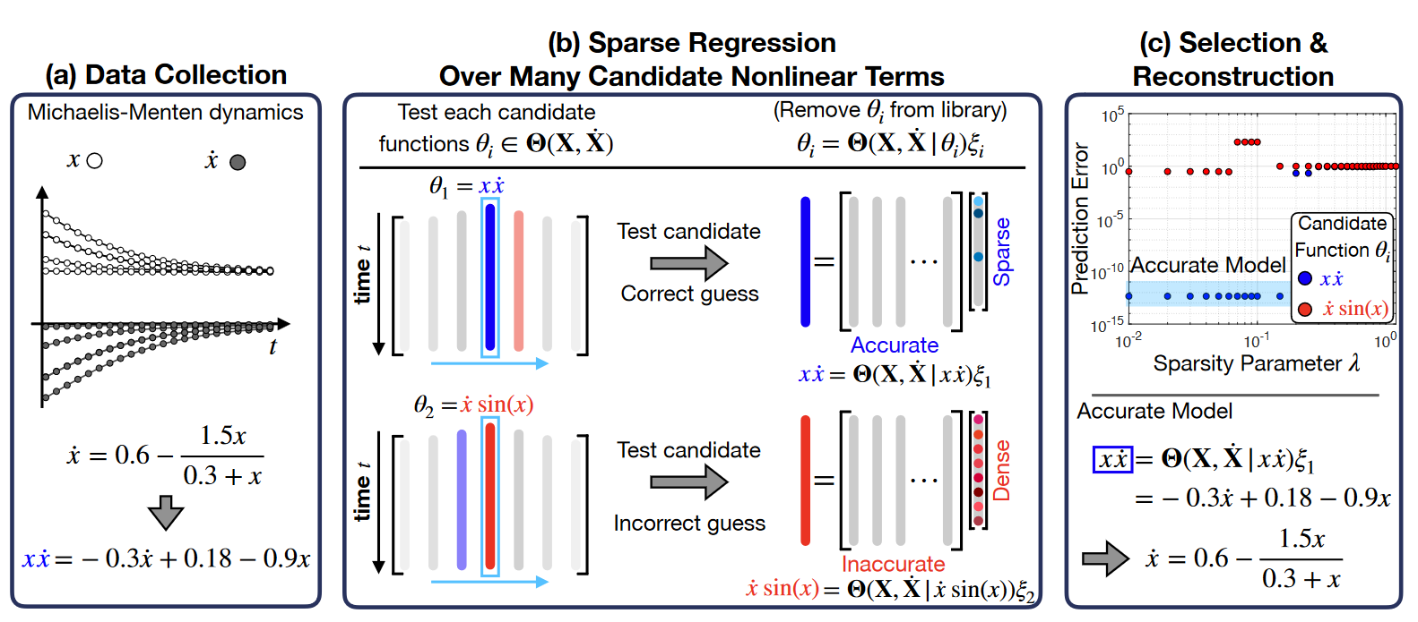
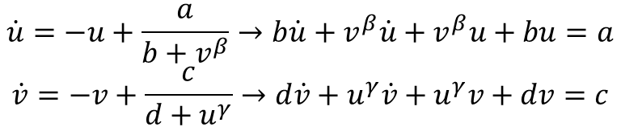
Method: SINDy-PI
$$C\left(X, \dot{X}\right)=Θ\left(X, \dot{X}\right)Ξ$$
LHS RHS Sparse
vector
PI = Parallel Implicit
Parallel
Tests multiple functions
Implicit
No more rational functions
SINDyPI algorithm
$$\dot{u}=−u+\frac{a}{b+v^{β}}→b\dot{u}+v^{β}\dot{u}+v^{β}u+bu=a$$
$$\dot{v}=−v+\frac{c}{d+u^{γ}}→d\dot{v}+u^{γ}\dot{v}+u^{γ}v+dv=c$$
Kaheman Kadierdan, Kutz J. Nathan and Brunton Steven L. 2020 SINDy-PI: a robust algorithm for parallel implicit sparse identification of nonlinear dynamics Proc. R. Soc. A.4762020027920200279
System in implicit form via algebra

Slide 13
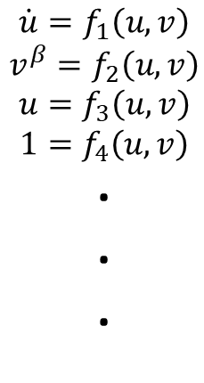
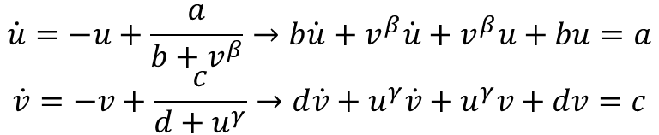
Method: SINDy-PI
$$\dot{u}=−u+\frac{a}{b+v^{β}}→b\dot{u}+v^{β}\dot{u}+v^{β}u+bu=a$$
$$\dot{v}=−v+\frac{c}{d+u^{γ}}→d\dot{v}+u^{γ}\dot{v}+u^{γ}v+dv=c$$
PI = Parallel Implicit
Parallel
Tests multiple functions
Implicit
No more rational functions
System in implicit form via algebra
$$\dot{u}=f_{1}\left(u, v\right)$$
$$v^{β}=f_{2}\left(u, v\right)$$
$$u=f_{3}\left(u, v\right)$$
$$1=f_{4}\left(u, v\right)$$
∙
∙
∙
Run SINDy on multiple library functions instead of derivatives to get multiple models
Kaheman Kadierdan, Kutz J. Nathan and Brunton Steven L. 2020 SINDy-PI: a robust algorithm for parallel implicit sparse identification of nonlinear dynamics Proc. R. Soc. A.4762020027920200279

Slide 14
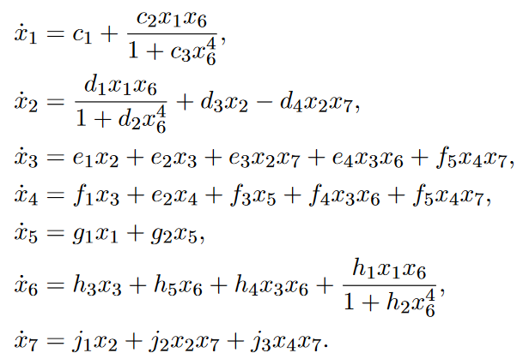
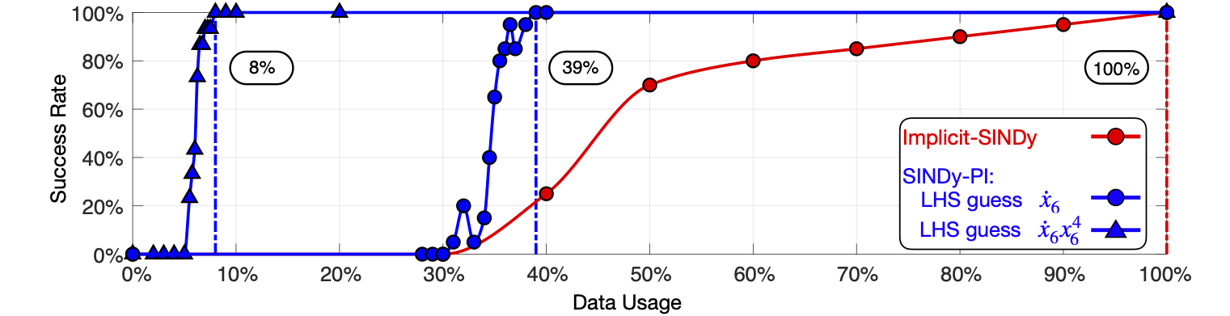
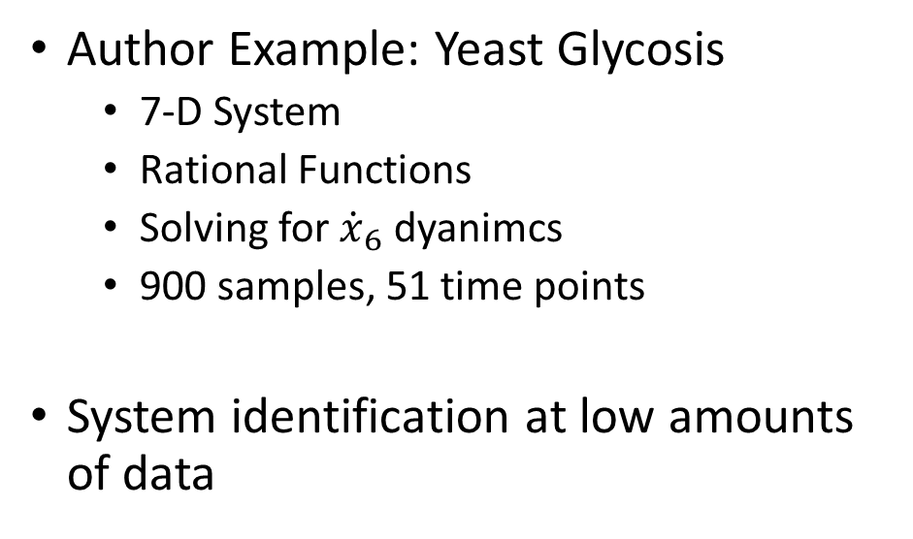
Method: SINDy-PI
Author Example: Yeast Glycosis
7-D System
Rational Functions
Solving for ${\dot{x}}_{6}$ dyanimcs
900 samples, 51 time points
System identification at low amounts of data
Kaheman Kadierdan, Kutz J. Nathan and Brunton Steven L. 2020 SINDy-PI: a robust algorithm for parallel implicit sparse identification of nonlinear dynamics Proc. R. Soc. A.4762020027920200279

Slide 15
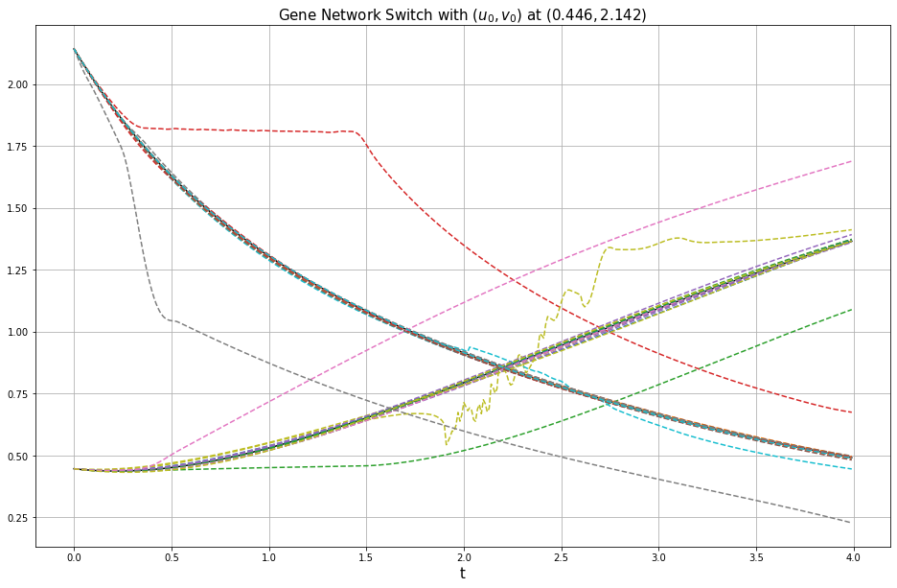
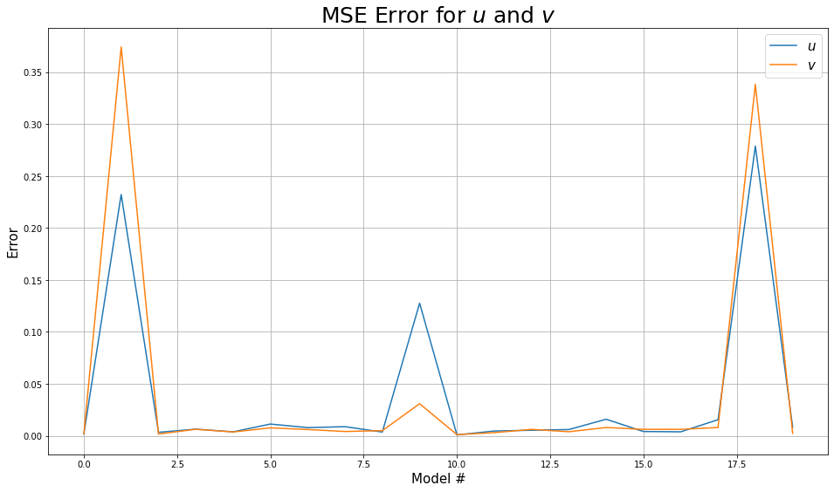
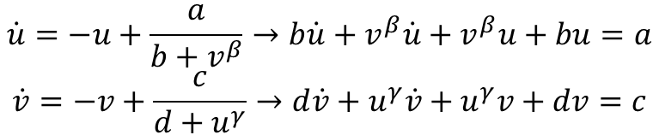
Method: SINDy-PI
Performance on Gene Switch
Polynomial degree 3
50 samples, 400 time points
$$\dot{u}=−u+\frac{a}{b+v^{β}}→b\dot{u}+v^{β}\dot{u}+v^{β}u+bu=a$$
$$\dot{v}=−v+\frac{c}{d+u^{γ}}→d\dot{v}+u^{γ}\dot{v}+u^{γ}v+dv=c$$

Slide 16
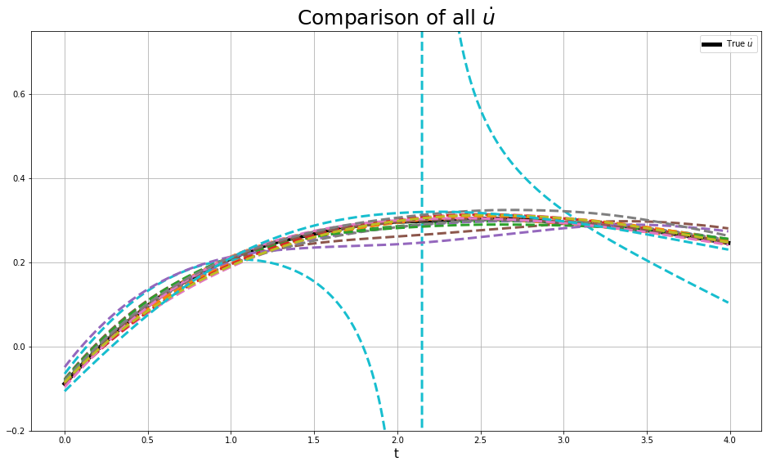
Method: SINDy-PI
Performance on Gene Switch
Polynomial degree 3
50 samples, 400 time points
$$\dot{u}=−u+\frac{a}{b+v^{β}}→b\dot{u}+v^{β}\dot{u}+v^{β}u+bu=a$$
$$\dot{v}=−v+\frac{c}{d+u^{γ}}→d\dot{v}+u^{γ}\dot{v}+u^{γ}v+dv=c$$

Slide 17

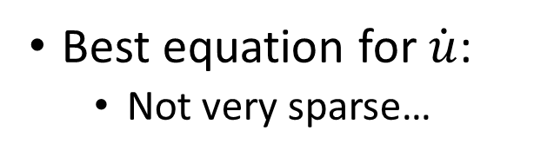
Method: SINDy-PI
Performance on Gene Switch
Polynomial degree 3
50 samples, 400 time points
$$\dot{u}=−u+\frac{a}{b+v^{β}}→b\dot{u}+v^{β}\dot{u}+v^{β}u+bu=a$$
$$\dot{v}=−v+\frac{c}{d+u^{γ}}→d\dot{v}+u^{γ}\dot{v}+u^{γ}v+dv=c$$
a, b, c, d, $β$, $γ$ = 1, 1, 1, 1, 1, 2
Best equation for $\dot{u}$:
Not very sparse…

Slide 18
Method: SINDy-PI
Possible Issues
Questionable performance w/o noise
Function Library
Insufficient sample size
Caveat: cvxpy error w/ large # of samples
Parallelization and feature count/scalability

Slide 19
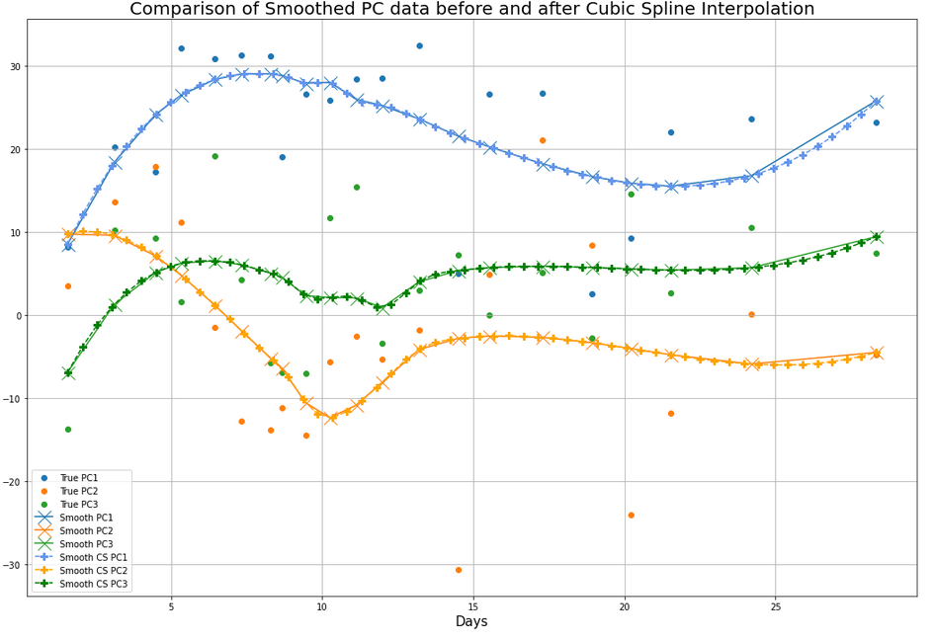
Data: INCOV
140 samples
Preprocessed for protein data
Incomplete time points
139 BL readings
132 AC readings
88 CV readings
453 features (proteins)
3 time points (BL, AC, CV)
tSMOTE imputation → 30 non-uniformly spaced time points (Day 1.5 – 138.5)
→ Restrict time frame to ~2 months (Day 1.5 – 28.3)
→ Savitzky-Golay filter → Data smoothing
→ Cubic-Spline interpolation → 56 time points

Slide 20
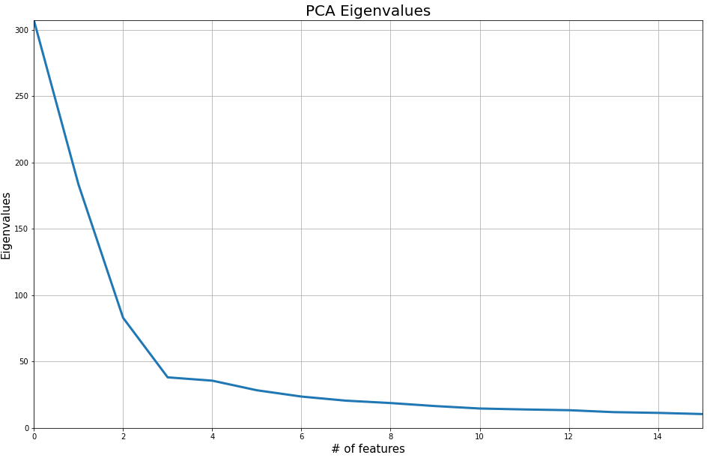
Data: INCOV
140 samples
Preprocessed for protein data
Incomplete time points
139 BL readings
132 AC readings
88 CV readings
453 features (proteins)
3 time points (BL, AC, CV)
PCA
Dimension reduction
3 principal components to use as features in pySINDy

Slide 21
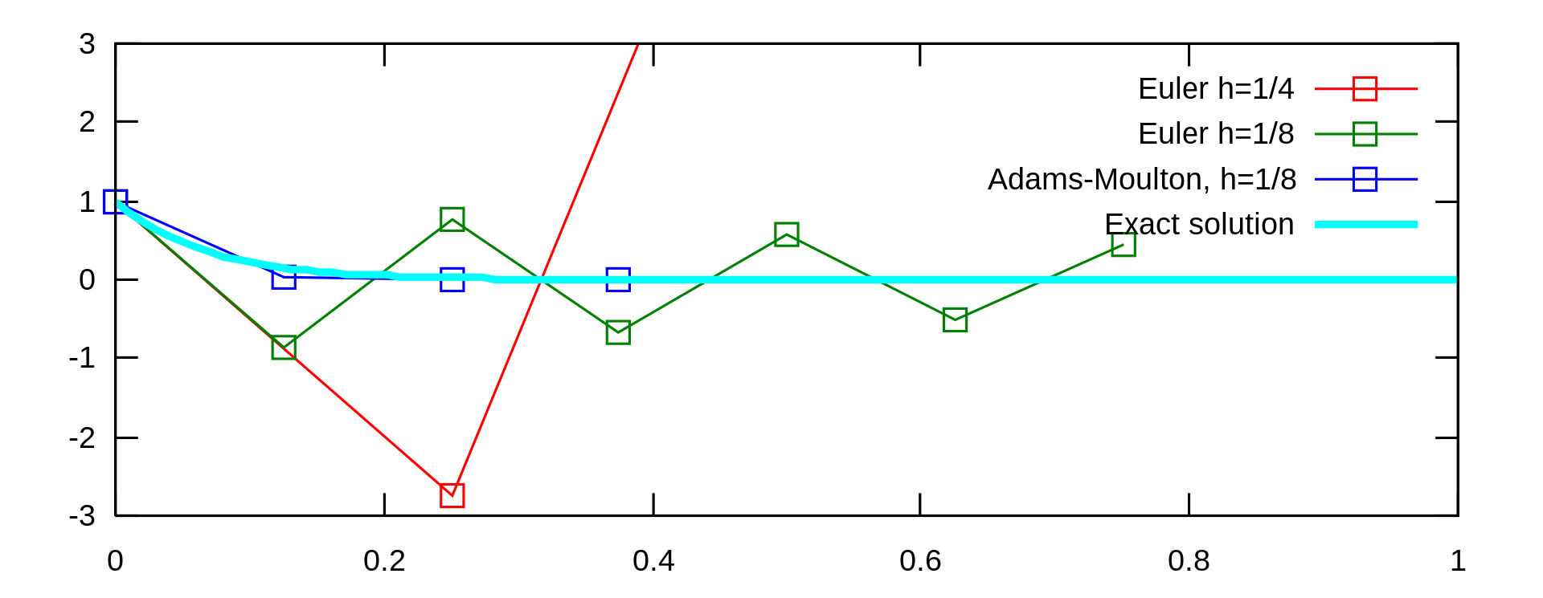
Data: INCOV
Complications
Filtering/interpolation obscures data
Simulating via numerical integration
Stiff Equations

Slide 22
Future Directions
Compare SINDy model to known biological system models
Known model vs. SINDy derived model
Higher dimensions examples to examine scalability
6-D Repressilator gene clock
Numerical solvers
Contact pySINDy + SINDyPI author
Model solving + simulation method

